Slide 1
Project Title: STP Attacks and Protection Mechanisms This project explores common attacks on the Spanning Tree Protocol (STP), such as BPDU spoofing and root bridge manipulation, and demonstrates effective countermeasures to secure network topology.

Slide 2
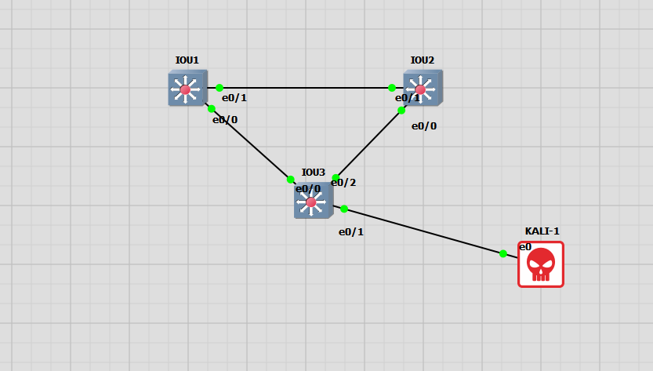





Slide 3
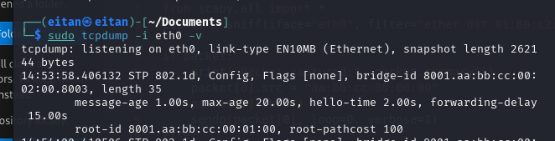


DEC | HEX | Value
32769 – vlan id number gets added to default of 32768 | 8001 aa:bb:cc:00:01:00 | Root Bridge Priority and MAC
128 | 80 | Port-Priority
3 | 3 | Port-id

Slide 4
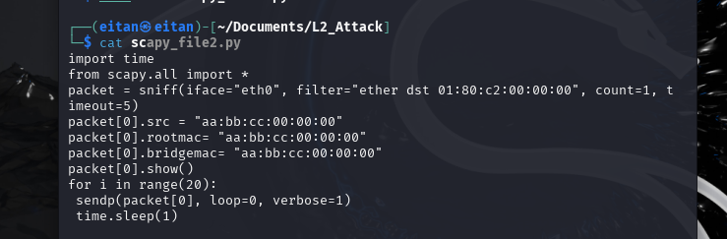
Caprute a configuration BPDU packet, alter it and send it 20 times back on the wire.
I leave the bridge/root priority at 32769(32768+vlan id)
Change the sending bridge mac to “aa:bb:cc:00:00:00”, which is the lowest
And most preferred and declare it as the root mac.

Slide 5
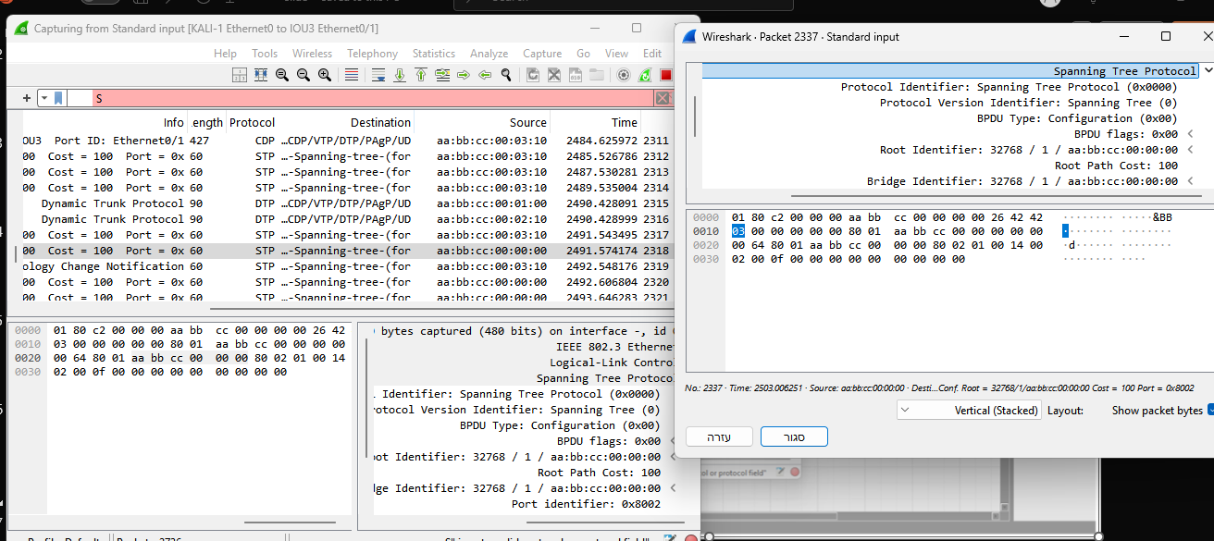
Wireshark capture - KALI-1_Ethernet0_to_IOU3_Ethernet01

Slide 6
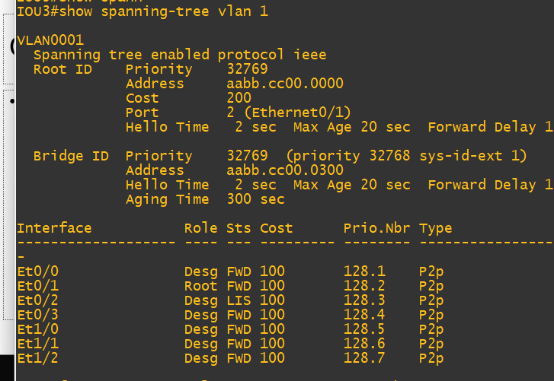
The switch connected to the KALI has chosen it for the ROOT ROLE
And egress port to The kali is a Root port now.

